Slide 1
Overview
Addressing comments
The balancing mechanism
Standardization
Supply
Production, Trade, Stock changes
Utilization
Feed, Food, Seed, FLW, Industry, Tourists, RoU
Classification

Slide 2
Why are we revising the methods?
Outdated methods and conversion factors
Outdated (dodgy) imputation methods for individual elements (feed, etc.)
Outdates, old conversion factors, extraction rates, nutrient conversion factors, numerous outliers (“historical baggage”, manual “adjustments”)
No formal balancing mechanism, not rules based, different “balancing items”. Therefore great subjective element in the results, differences across countries and commodities, not reproducible.
IT/ICTs: end of IT support by FAO CIO, Fortran 4 code. Black box.
Points 1, 2 and 3 have led to growing quality issues in the FBS, many instances of negative utilization (ARG palmoil).
Heavy manual workload in the absence of formal mechanisms and balancing issues; this holds for all elements of the estimation and balancing process.
Inexistent, partial, or outdated documentation of the existing system (AUPUS)
Outdated, partial and incomplete capacity development package (only “orange book”).

Slide 3
Basic principles guiding the FBS innovations
Recognize that FBS are analytical datasets. They combine measured and imputed/estimated data.
Maximize coverage with measured data, minimize imputation.
When imputing, use accurate methods.
Explicitly account for measurement errors for both imputed and empirically measured data.
Make all assumptions explicit, document them.
Make use of new IT options where possible, reap efficiency gains. Accept small errors if they offer large resource savings.

Slide 4
Peer Review Comments

Slide 5
Peer Review Comments
Need for simplified document: Simpler document and training material to be developed in coming months.
GS Involvement: Involvement with analytical databases (e.g. also SEEA).
Reference documents: Will be made available
SUT and IO: SUT tables also exist in quantities. FBS values have been considered but challenging to interpret and utilize. Interrelationship.
Balancing Algorithm Literature: Developed independently of literature, but will now incorporate.
Argentina Negative Utilization: Issue with the old approach when standardizing oil to the wrong parent in the commodity tree (see later slide).

Slide 6
Basic balance and balancing mechanism
Peer Review Comments
m² conversion factor: Only applies to a few cases, but we’re investigating this problem.
Import/Export equations: Total imports equals total exports, there was a typo.
AGRIS: Stock (on farm) surveys are included
Shapiro-Wilk test: Normality should be rejected.
Feed from surveys: Often, only compound feed is measured/reported. No on-farm concentrates!
Estimation of variance: As imputations become refined, we’ll use them to estimate means and variances.

Slide 7
Peer Review Comments
In country use:
Efforts will be made to provide training materials explaining the complex ideas more clearly.
Extraction rates and conversion factors used will be supplied to countries for verification/updating.
Complex methods are necessary to accurately model real world scenarios.
PPP presentations are ready. Ditto for a menu-driven, Shiny&R based package that allows countries to produce their FBS; prepopulated with FAO parameters and data.

Slide 8
Next steps

Slide 9
Next steps
Incorporate comments of the SAC
Roll out methodology at FAO (already underway)
Complete CD material, develop a suite of CD products
Country based working system is ready
PPP are ready
Video to be prepared
E-learning material to be prepared
Dialogue with countries to continue the review of extraction rates and conversion factors.
See where simple approaches can replace complex models
AMIS-like balances for market analysis to be added to a suite of products

Slide 10
Basic balance and balancing mechanism

Slide 11
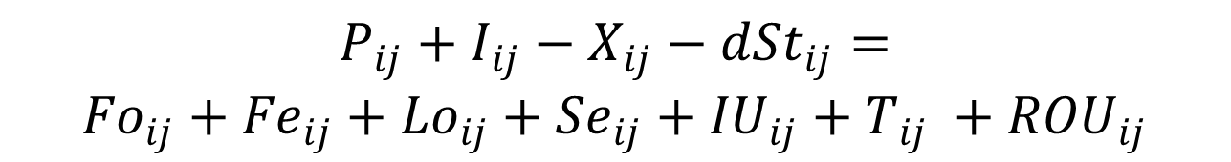
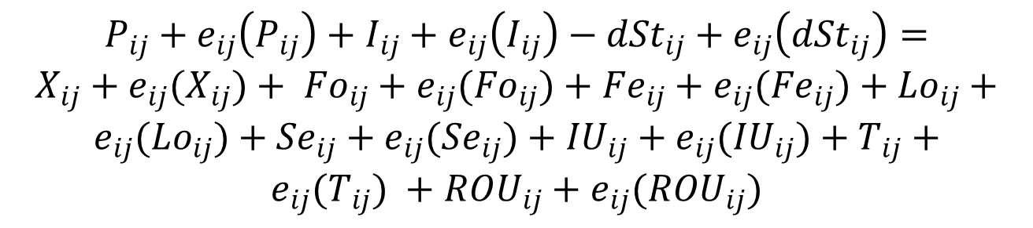
The basic balance
1. Without measurement errors
$$P_{ij}+I_{ij}−X_{ij}−{dSt}_{ij}=$$
${Fo}_{ij}+{Fe}_{ij}+{Lo}_{ij}+{Se}_{ij}+{IU}_{ij}+T_{ij} +{ROU}_{ij}$
2. With measurement errors
$$P_{ij}+e_{ij}\left(P_{ij}\right)+I_{ij}+e_{ij}\left(I_{ij}\right)−{dSt}_{ij}+e_{ij}\left({dSt}_{ij}\right)=$$
$X_{ij}+e_{ij}(X_{ij})+ {Fo}_{ij}+e_{ij}({Fo}_{ij})+{Fe}_{ij}+e_{ij}({Fe}_{ij})+{Lo}_{ij}+e_{ij}({Lo}_{ij})+{Se}_{ij}+e_{ij}({Se}_{ij})+{IU}_{ij}+e_{ij}({IU}_{ij})+T_{ij}+e_{ij}(T_{ij}) +{ROU}_{ij}+e_{ij}({ROU}_{ij})$

Slide 12

The basic challenge/solution
A. Basic problem
1. balancing item/residual assumes all measurement errors
2. measurement errors do not (necessarily) cancel out:
B. Solution
No residual, but all variables to be identified, with expected value and measurement error
Selecting the combination of variables that maximizes overall likelihood (most probable solution)
$$\sum{eij ≠0}$$

Slide 13
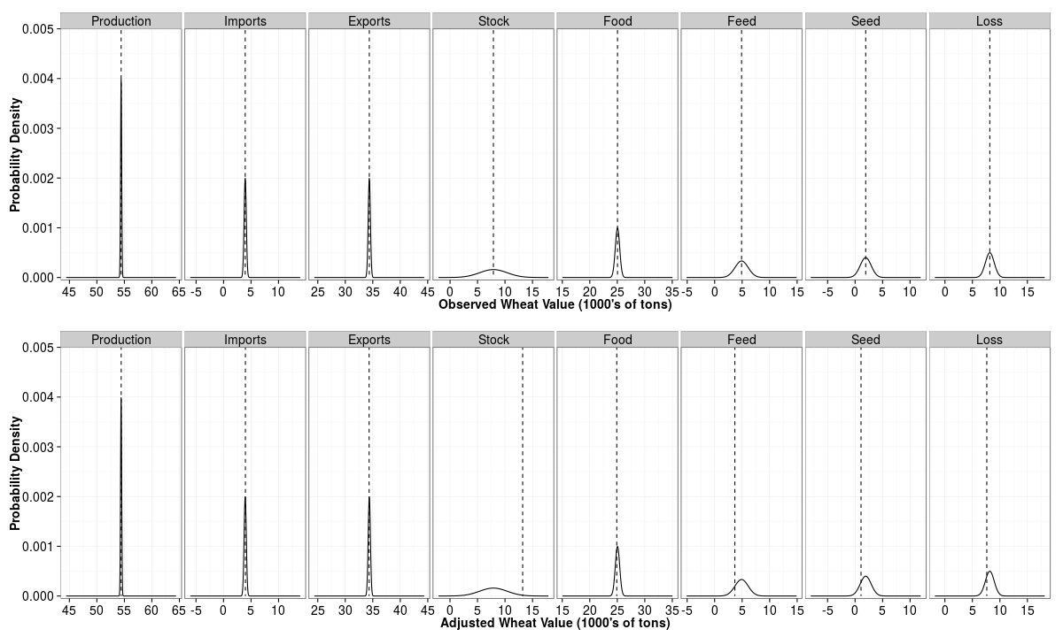
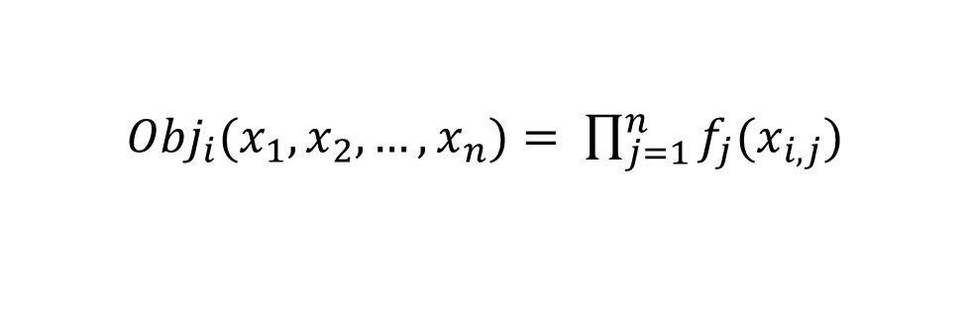
${Obj}_{i}(x_{1}, x_{2}, …,x_{n})= \prod_{j=1}^{n}{f_{j}(x_{i,j})}$

Slide 14
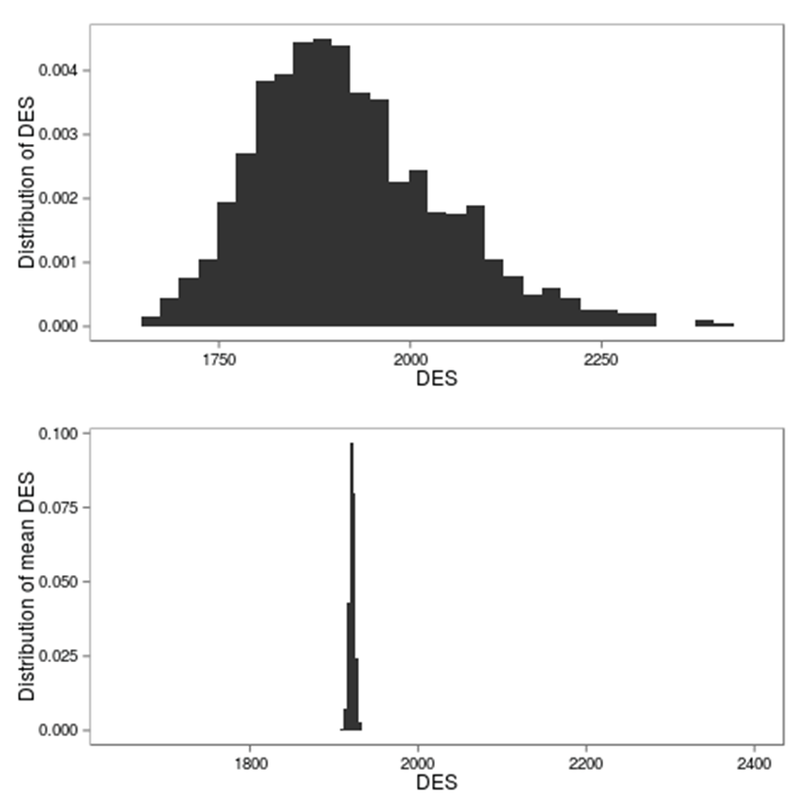
Measurement error

Slide 15
Confidence levels based on FAOSTAT flags
Source | Confidence | Implied Measurement Error
Official | 1.0 | 0.0%
Semi-official | 0.9 | 10%
Imputed | 0.85 | 15%
Estimated | 0.6 | 40%
Missing | NA | NA

Slide 16
Standardization

Slide 17
Why Standardization?
Convert a large number of processed/derived products back into their primary equivalents
Establish a balance at primary level (some products remain in the FBS as processed commodities)
Calculate nutrient availability, total and by product (calories, fat and protein, others possible)
Complex (and simple) connections between primary and processed products, example wheat:

Slide 18
Standardization Network

Slide 19
Standardization problems
Inappropriate shares, outdated trees
Inconsistent application of trees over different SUA/FBS variables (trade v production)
Extraction rates outdated, out-of range
“Endogenous” extraction rates, variable over time and not intuitive in their levels
Commodity composition in trade flows not taken into account, (Argentina exports margarine to the EU, based on different oils).

Slide 20
Visible problems: e.g. negative utilization

Slide 21
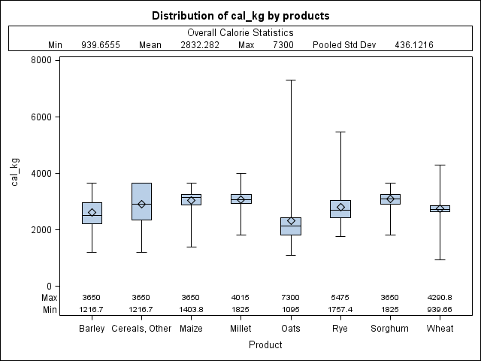
Visible problems: high variability of calorie content

Slide 22
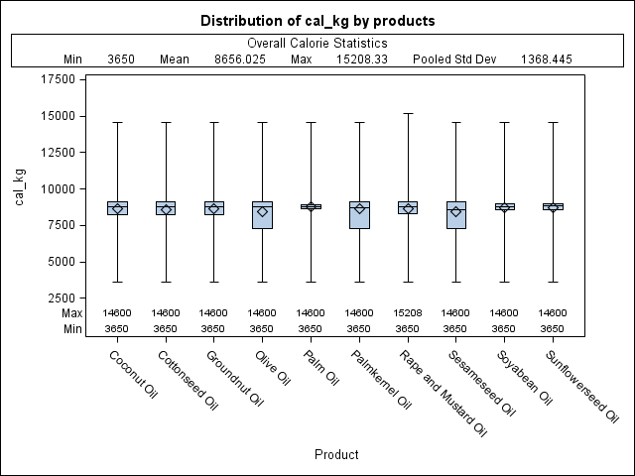
Implicit calorie contents: Oils

Slide 23
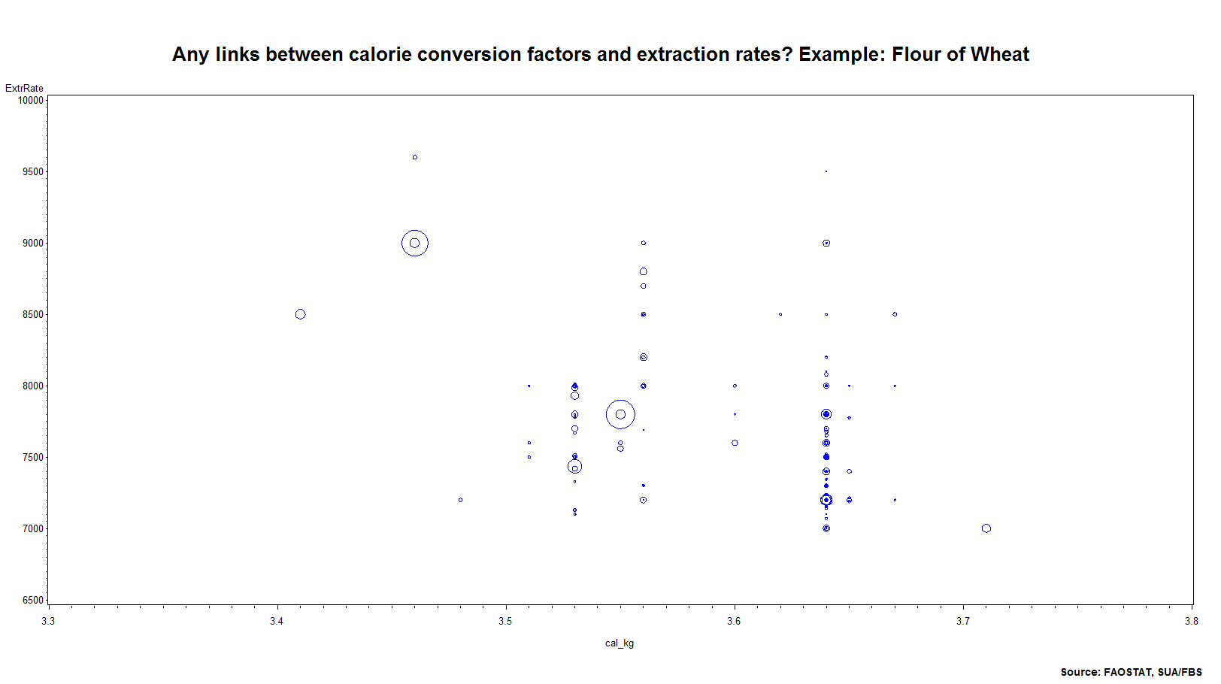

Slide 24
Importance of extr rates vs calorie conversion factors
Year | Extr Rate | cal_kg
1961-2007
Min: | 6,380 | 3,320
Max: | 9,722 | 3,870
 | 52% | 17%
Processed (food primary) * Extraction Rate = Production of processed
Production of processed * Cal/kg = Calories from domestic processed
+ Imports of processed * Cal/kg = Calories from imports
- Exports of processed * Cal/kg = Calories from exports
Calories available from processed products at domestic market
Processed (food primary) * Extraction Rate * Cal/kg = Calories from domestic processed

Slide 25
Large differences across countries

Slide 26
Implicit extraction rates over time: Declining for Japan?

Slide 27
Summary of Changes
 | Previous Standardization Process | New Standardization Process
Extraction Rates | Adjusted extraction rates when food was estimated and production available. | Adjust estimated food with extraction rate.
Shares | Shares often constant over countries and commodities | Shares based on availability of parents.
Commodity Trees | Elements used different trees. | Elements/variables use the same commodity trees.
Nutrient conversion factors | Regional averages for nutrient conversion factors | Country-specific conversion factors where available.
Trade flows and product shares | No trade-flow specific shares. | Trade-flow specific shares for the composition of processed products (not yet implemented).
Explicit assumptions | Many assumptions were undocumented and unclear. | All assumptions are thoroughly documented.

Slide 28
Supply

Slide 29
Production

Slide 30
Production Imputation
Ten different models are fit to the historical data (mean, linear regression, exponential regression, logistic regression, etc.)
Each model is evaluated based on how well it fits the particular commodity time series.
The final imputation is computed as a weighted average of the 10 predictions from the individual models.
The weights are calculated based on how well the models fit the data.
The approach has been tested very successfully inside FAO, most recently the updates of the FAO production statistics for 2013 and 2014.

Slide 31
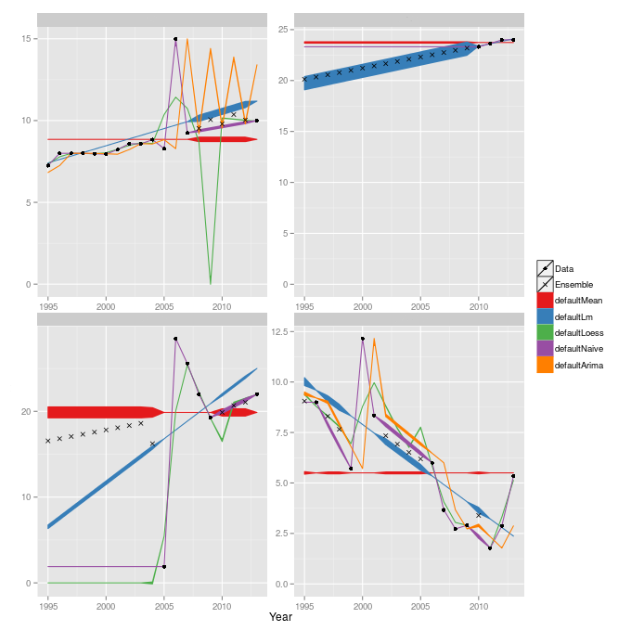
Production Imputation
More complex models are favored when the data support such models.
Simpler models are favored when the data is sparse.
This provides flexible, automatic imputation.

Slide 32
Trade

Slide 33
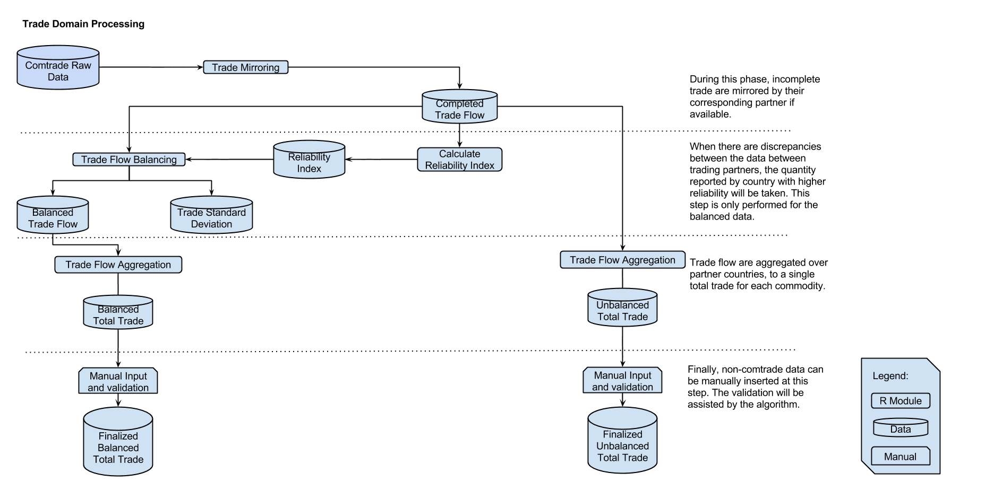
Trade process flow

Slide 34
Trade Products
Dissemination products | 1. UN Comtrade | 2. Mirrored flows | 3. Balanced trade
Matrixes of flows | Cleaned for errors. | Same as 1, but also | Same as 2, but also
 | Cleaned for misreporting | Data gaps filled thru mirroring | Official over-written, where necessary
 | No data overwritten | IUV/EUV calculated and data gaps filled thru imputation | Balanced trade, endorsement factors
 | No data added | Official data kept intact
Total trade | 4. Imbalanced official | 5. Mirrored and imputed | 6. Balanced trade
 | Total exports and imports by country, but sum of exports doesn’t equal sum of imports. | Total exports and imports by country, but sum of exports doesn’t equal sum of imports. | Total exports and imports by country and sum of exports equals sum of imports.

Slide 35
Unit Values
Country specific unit values are more accurate than global.
Only used in cases where the data supports this (i.e. at least 5 known unit values for this country).

Slide 36
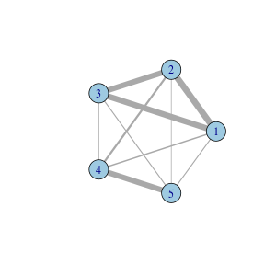
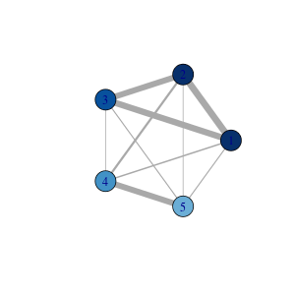
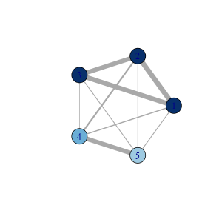
Reliability Scores, Endorsement index
Reliability scores are computed using agreement in trade flows.
An algorithm is used to measure connectedness in the graph and specify how well a particular country agrees with the other reporters.
Endorsement based on reliability of trading partners and overlap/agreement (GTAP only based agreement, each partner with equal weight)

Slide 37
Stock changes

Slide 38
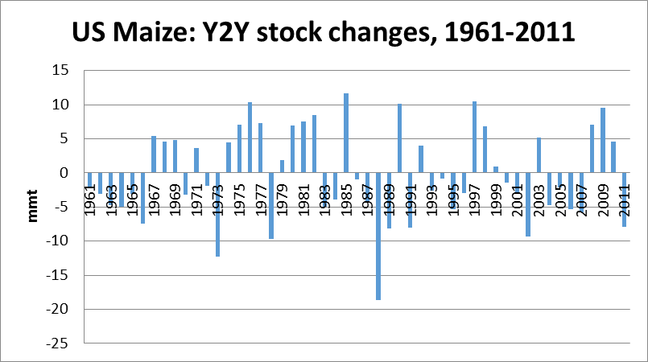
Stock changes: long-term mean=0

Slide 39
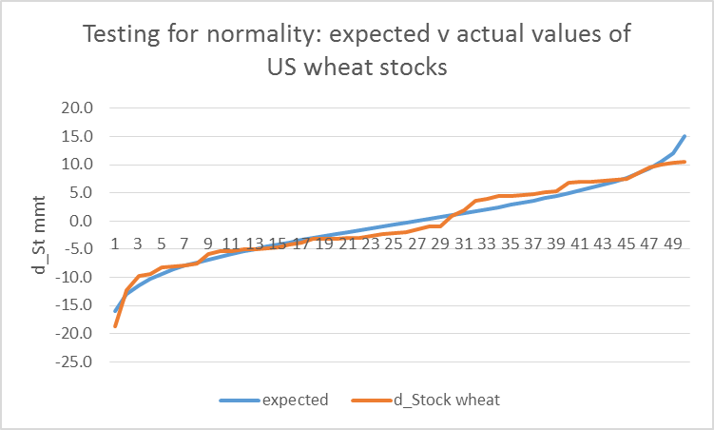
Stock changes of wheat: Normally distributed

Slide 40
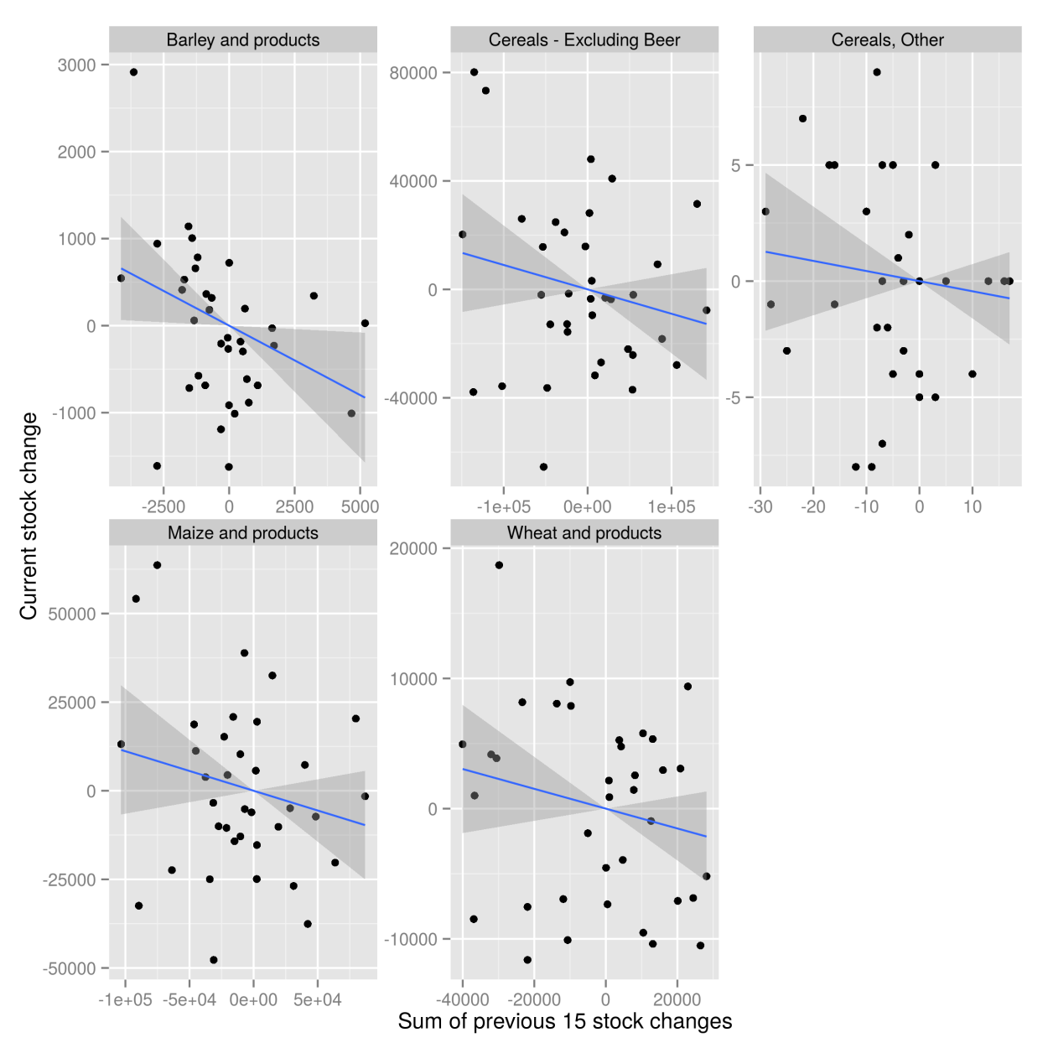
Stock Changes- Distribution
More information can be gained if we consider historical changes.
Positive (cumulative) past changes suggest a negative change in the current year, and vice versa.
Model:

Slide 41
Utilization

Slide 42
Feed Use

Slide 43
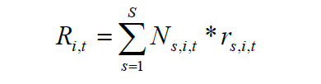

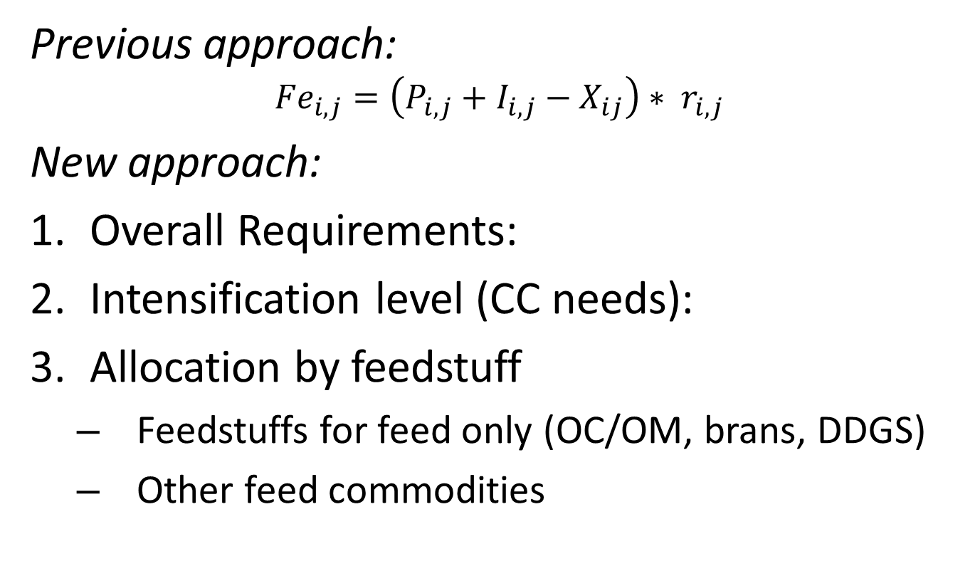
Feed use
Previous approach:
$${Fe}_{i,j}=\left(P_{i,j}+I_{i,j}−X_{ij}\right)∗ r_{i,j}$$
New approach:
Overall Requirements:
Intensification level (CC needs):
Allocation by feedstuff
Feedstuffs for feed only (OC/OM, brans, DDGS)
Other feed commodities

Slide 44
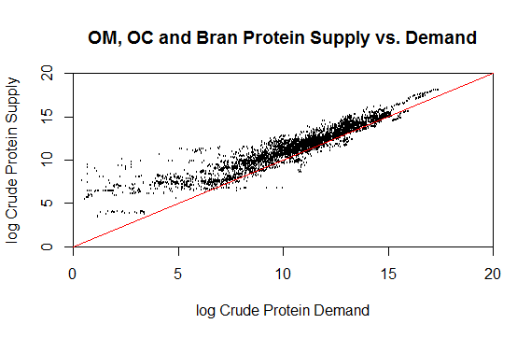
Oil meals, Oil cakes, DDGS and Brans

Slide 45
Cereals

Slide 46
Food Use

Slide 47
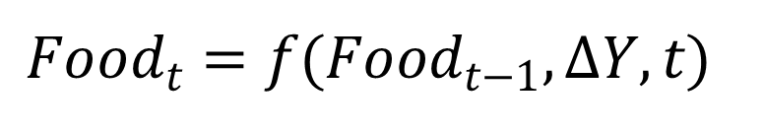
Food
Econometrics-based model:
Computes food in year t as a function of food in year t-1, the change in income of the country, and the elasticity of a particular commodity.
Food as the balancing item where the only use is food (in essence meat, etc.)
$${Food}_{t}=f({Food}_{t−1}, ∆Y,t)$$

Slide 48
Tourist consumption

Slide 49
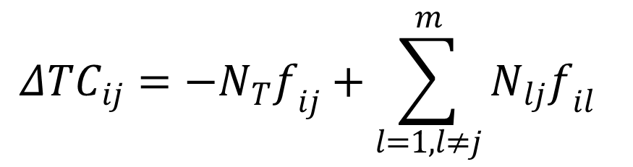
Tourist Consumption
Using data from UNWTO, we can compute the total number of days tourists from any particular country stayed in any other country.
From this data, we can add/subtract calories from the destination/origin countries, respectively:
$${ΔTC}_{ij}=−N_{T}f_{ij}+\sum_{l=1,l≠j}^{m}{N_{lj}f_{il}}$$

Slide 50
Industrial use

Slide 51
Industrial Use

Slide 52
Residual Other Uses (OU-IU-TC)
We assume a simple distribution with largest probability at zero.
We can adjust the decay of the density based on the commodity and country.

Slide 53
Losses (FLW)

Slide 54
Losses
Loss data is notoriously sparse
Estimation of missing data often requires grouping “similar” observations
We use a hierarchical linear model which imputes with the most specific data available
Also is capable of estimating losses for scenarios with little data

Slide 55
Loss Hierarchy
Non-perishable
Cereals
Fruits
Wheat
Maize
Albania
…
…
Afghanistan
…
…
Afghanistan
Albania
…
Pulses
Fruits and Vegetables
Animal Products
…
…

Slide 56
Seed

Slide 57
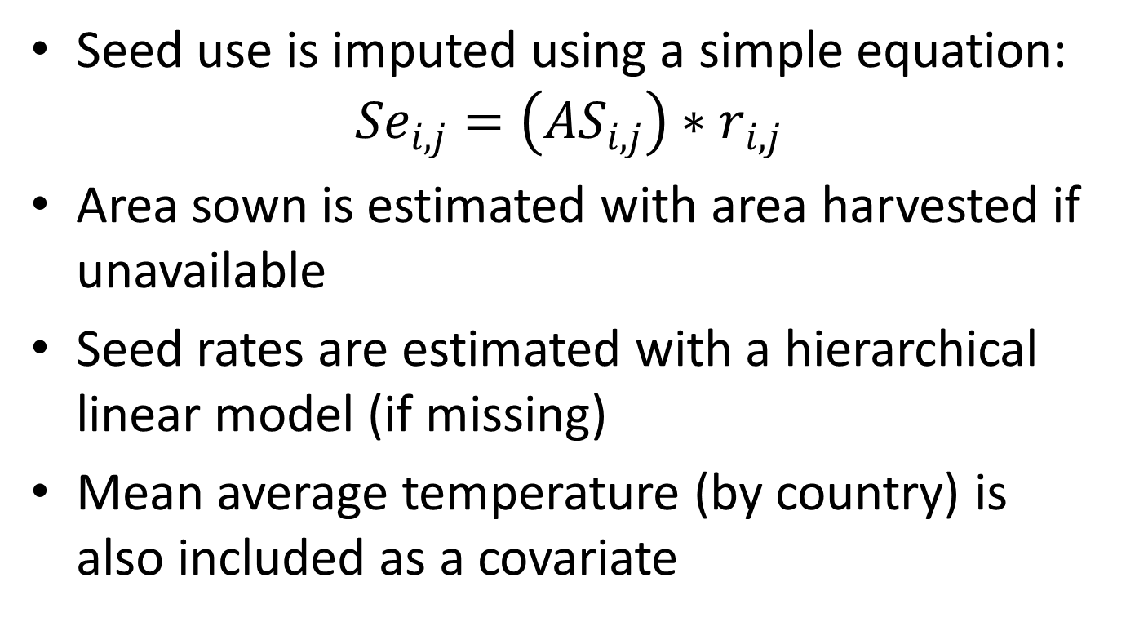
Seed
Seed use is imputed using a simple equation:
$${Se}_{i,j}=\left({AS}_{i,j}\right)∗r_{i,j}$$
Area sown is estimated with area harvested if unavailable
Seed rates are estimated with a hierarchical linear model (if missing)
Mean average temperature (by country) is also included as a covariate

Slide 58
Seed Hierarchy
CPC = 011…
CPC = 0111 (wheat) and Afghanistan
CPC = 0111 (wheat) and Algeria
…
CPC = 0112 (maize) and Afghanistan
CPC = 0112 (maize) and Algeria
…
CPC = 012…
…
CPC = 01211 (asparagus) and Afghanistan
CPC = 01211 (asparagus) and Algeria
…
CPC = 01211 (cabbages) and Afghanistan
CPC = 01212 (cabbages) and Algeria

Slide 59
Classifications

Slide 60
Classifications
FCL is the historical classification system of FAO
Effective system, but has it’s drawbacks:
It has never been updated (7 versions of HS since the ‘80s, the same FCL)
There is no governance mechanism to manage and review it
There is no consultation to meet the users’ needs and the developments in the agro-food system has never been carried out
Codes are not always consistent
Commodity definitions are structured in a way to combine data from the production and the trade domain, which may introduce ambiguities and errors
It is “isolated”: only used by FAO and not by countries or other organizations; it does not allow integration of agricultural statistics with statistics from other domains

Slide 61
The CPC System
Codes for “Sweet potatoes” in CPC Ver.2 (0122 in FCL)

Slide 62
Expanding the CPC System
CPC expanded code for “Mixed grain” (0103 in FCL)

